Slide 1
Clustered Crowd GPS for Privacy Valuing Active Localization
Benjamin C Hurdins
S7R, rollno:19
Department of CSE , MACE
08/10/2018

Slide 2
CONTENT
Clustered Crowd GPS for Privacy Valuing Active Localization
Introduction
Concept of Crowd sourcing
BLE technology
Proposed system
Socio Tracking Distance
Clustering of users
Challenges
Conclusion

Slide 3
INTRODUCTION
Clustered Crowd GPS for Privacy Valuing Active Localization
Need to find lost items
Use a common feature in smart phones
Use the crowd to get information
Cluster users based on their offered benefit

Slide 4
CROWD SOURCING
Clustered Crowd GPS for Privacy Valuing Active Localization
Definition : crowd sourcing
Example : image tagging
Spatial crowd sourcing

Slide 5
BLE TECHNOLOGY
Clustered Crowd GPS for Privacy Valuing Active Localization
BLE : Bluetooth Low Energy
Low cost near range communication
Bluetooth : common in most smart phones
Range :
class 1: 100m
class 2 : 10m
class 3 : 1m

Slide 6
BLE TECHNOLOGY (contd..)
Clustered Crowd GPS for Privacy Valuing Active Localization
BLE tags : cheap and common in market
Price :200 INR +
Battery life : 1.5yrs or more
Existing usage :Indoor localizations

Slide 7
BLE TECHNOLOGY (contd..)
Clustered Crowd GPS for Privacy Valuing Active Localization
Other near communication options :
NFC tag ,QR code , RFID tags
Technology common in smart phones
Device should come in contact with tag
Some interaction from user required

Slide 8
BLE TECHNOLOGY (contd..)
Clustered Crowd GPS for Privacy Valuing Active Localization
Other applications:
indoor localization, navigation , ticketing
Indoor localization: use Received Signal Strength Indication (RSSI)
But for BLE close proximity required

Slide 9
PROPOSED SYSTEM
Clustered Crowd GPS for Privacy Valuing Active Localization
Cluster users based on benefit offered in finding object
Socio Tracking Distance(STD) metric
Clustering of users
Greedy clustering algorithm

Slide 10
PROPOSED SYSTEM (contd..)
Clustered Crowd GPS for Privacy Valuing Active Localization
Not passive interactions :active
Based on historical visit patterns
Determined by group size
Fee based incentives – additional feature

Slide 11
Clustered Crowd GPS for Privacy Valuing Active Localization
PROPOSED SYSTEM (contd..)
When pair is considered : less benefit
no network level optimization
Keep minimum user interactions
User privacy : maximum
08/11/2018
DEPT OF CSE, MACE KOTHAMANGALAM
11

Slide 12

SOCIO TRACKING DISTANCE
Clustered Crowd GPS for Privacy Valuing Active Localization
Let a = (ts, te, locid ) denote a visit event by a user a
All of the visits of a user at that location represented with a set Va
probability of all users in the same location and their delay.
find the weighted average of these delays over all possible locations

Slide 13
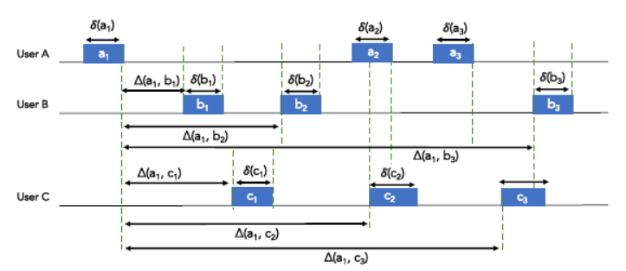
Clustered Crowd GPS for Privacy Valuing Active Localization
SOCIO TRACKING DISTANCE(contd..)
courtesy: https://ieeexplore.ieee.org/stamp/stamp.jsp?tp=&arnumber=8347087

Slide 14
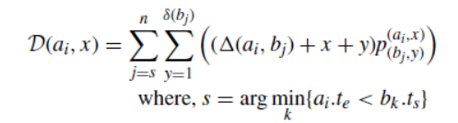
SOCIO TRACKING DISTANCE (contd..)
Clustered Crowd GPS for Privacy Valuing Active Localization
user A lost an item x time units before current visit, ai
the average delay of finding it by user B will be :

Slide 15

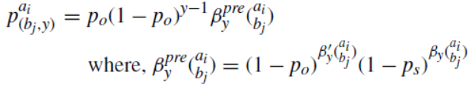


SOCIO TRACKING DISTANCE (contd..)
Clustered Crowd GPS for Privacy Valuing Active Localization
denotes the probability of finding the item where
denotes the sum of visit durations of the owner
denotes the sum of visit durations of other users between ai and bj

Slide 16
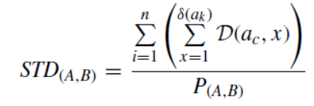
SOCIO TRACKING DISTANCE (contd..)
Clustered Crowd GPS for Privacy Valuing Active Localization
iterate through all possible losing times to calculate the STD
numerator is the sum of products of probabilities and delays
denominator is the sum of all probabilities used

Slide 17
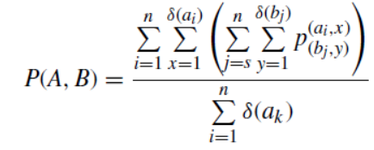
SOCIO TRACKING DISTANCE (contd..)
Clustered Crowd GPS for Privacy Valuing Active Localization
The probability that it will be found by B is:
STD value for some pair of nodes vary at different locations.

Slide 18
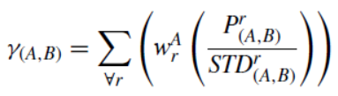

SOCIO TRACKING DISTANCE (contd..)
Clustered Crowd GPS for Privacy Valuing Active Localization
weighted satisfaction value for B in any locations visited by A
denotes the weight of the region r
total visit durations by A in r in all visit durations in all regions

Slide 19


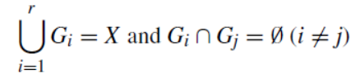
CLUSTERING OF USERS
Clustered Crowd GPS for Privacy Valuing Active Localization
Let the set of users in the network be
group of users, Gi, is a subset of X
the set of all groups is denoted by:
where

Slide 20


CLUSTERING OF USERS (contd..)
Clustered Crowd GPS for Privacy Valuing Active Localization
GREEDY CLUSTERING ALGORITHM
initially N different clusters : each cluster -single user
Merging of two different groups in current set of groups, G
Find the maximum possible increase in the objection function
no merging with a positive increase : algorithm stops

Slide 21
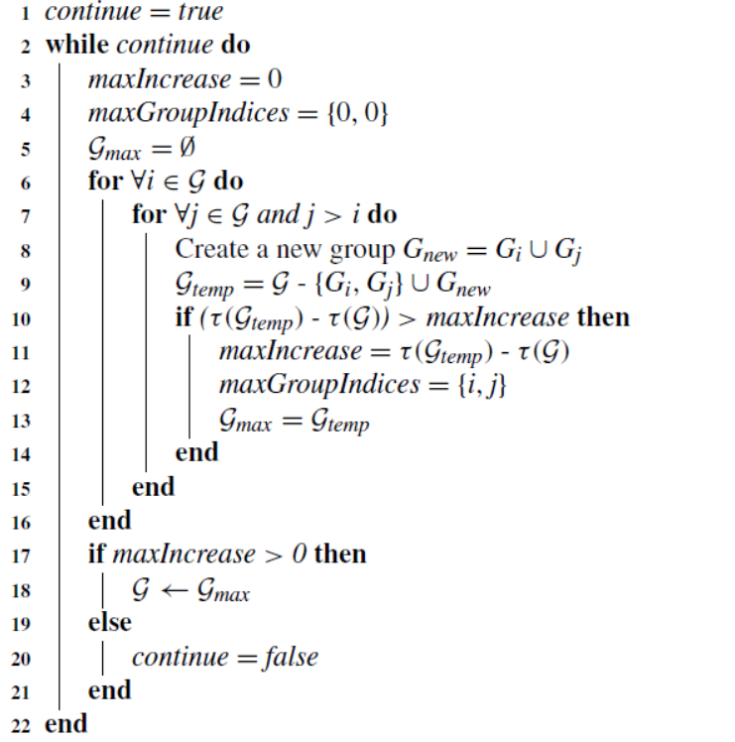
CLUSTERING OF USERS (contd..)
Clustered Crowd GPS for Privacy Valuing Active Localization

Slide 22
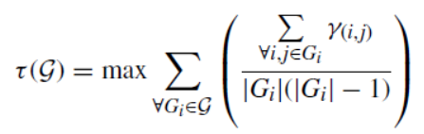

CLUSTERING OF USERS (contd..)
Clustered Crowd GPS for Privacy Valuing Active Localization
Objective function is given by
users of same group interact for active localization
there exists interactions in group i.

Slide 23
CHALLENGES
Clustered Crowd GPS for Privacy Valuing Active Localization
the benefit with increasing number of users participating
indoor areas :the GPS information is not available or accurate
lack of acceptance BLE tags

Slide 24
CONCLUSION
Clustered Crowd GPS for Privacy Valuing Active Localization
the localization of lost tags is achieved in the background
no intruding into the mobility of users
rewarding system will attract more users

Slide 25
REFERENCES
Clustered Crowd GPS for Privacy Valuing Active Localization
[1] Pixie. (Mar. 2017). The Nation's Biggest Lost and Found Survey. [Online].
Available: https://getpixie.com/blogs/news/lostfoundsurvey
[2] N. Guy. (Oct. 2017). The Best GPS Trackers for Cats and Dogs. [Online].
Available: https://thewirecutter.com/reviews/best-gps-pet-trackers/
[3] R. Edwards. Best Wearable GPS Trackers for Kids Buyers Guide.
Accessed: Apr. 2018. [Online]. Available: https://www.safewise.
com/resources/wearable-gps-tracking-devices-for-kids-guide
[4] K. Bishop. (2017). Growth Business: GPS Tracking. The Elderly.
[Online]. Available: https://www.cnbc.com/2014/03/11/growth-businessgps-
tracking-the-elderly.html
[5] C. Gomez, J. Oller, and J. Paradells, ``Overview and evaluation of bluetooth
low energy: An emerging low-power wireless technology,'' Sensors,
vol. 12, no. 9, pp. 1173411753, 2012.
[6] thetileapp.com. (2016). Tile Bluetooth Tracker Device. [Online].Available:
https://www.thetileapp.com
[7] TraxFamily.com. (2016). A Really Small and Light GPS Tracker for Kids
and Pets. [Online]. Available: https://traxfamily.com

Slide 26
REFERENCES(Contd..)
Clustered Crowd GPS for Privacy Valuing Active Localization
[8] S. Cohen. (2015). Locus Pocus Can Track all Your Bluetooth
DevicesAnd Other People's, Too, VentureBeat. [Online]. Available:
http://venturebeat.com/2015/06/06/locus-pocus-can-trackall-yourbluetooth-
devices-and-other-peoples-too
[9] J. Zhang, F. Tang, L. Barolli, Y. Yang, andW. Xu, ``Information gain based
maximum task matching in spatial crowdsourcing,'' in Proc. IEEE 31st Int.
Conf. Adv. Inf. Netw. Appl. (AINA), Mar. 2017, pp. 886893.
[10] L. Kazemi and C. Shahabi, ``GeoCrowd: Enabling query answering with
spatial crowdsourcing,'' in Proc. 20th Int. Conf. Adv. Geographic Inf. Syst.,
2012, pp. 189198.
[11] E. Bulut and B. K. Szymanski, ``Identifying the space buddies to track lost
items,'' in Proc. 2nd Int. Workshop Social Sens., 2017, pp. 6974.
[12] A. Campbell, ``The rise of people-centric sensing,'' in Distributed
Computing and Networking. ICDCN 2009 (Lecture Notes in Computer
Science), vol. 5408, V. Garg, R. Wattenhofer, and K. Kothapalli,
Eds. Berlin, Germany: Springer, 2008. [Online]. Available:
https://link.springer.com/chapter/10.1007%2F978-3-540-92295-7_3

Slide 27
THANK YOU

